Slide 1
AC22005
Section 2 - Lecture 13
Bus Architectures

Slide 2
Outline of today’s lecture
  introduction
  development of bus hierarchies
  expansion and high speed buses
  disk drive and graphics buses
  USB, PCIE and SATA
  the main hardware features of a PC

Slide 3
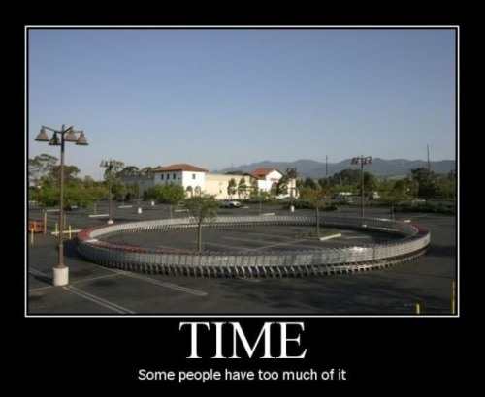
Thought for the Day

Slide 4

Graph of the Day

Slide 5
What is a bus?
A bus is a pathway that inter-connects two or more components in a computer:
  a bus is made up of a number of lines, which collectively carry a signal
  any signal put onto the bus is available for receipt by all other components that are connected to the bus
A system of buses enables the CPU to talk to memory and I/O devices. A collection of inter-connected buses is called a bus hierarchy.

Slide 6
PC architecture
There have been two major defining factors in PC architecture (over time):
  CPU architecture:
    e.g. x86, Pentium x, Core x
  Bus architecture:
    e.g. AT bus, ISA bus, PCI bus, AGP bus
Processor
log (Speed)
Disk drives & networks
Keyboards & mice
Year

Slide 7
Originally … no hierarchy
Main
Memory
CPU
VDU
Serial
Keyboard
Disk
System Bus*
* Data Bus, Address Bus and Control Bus together

Slide 8
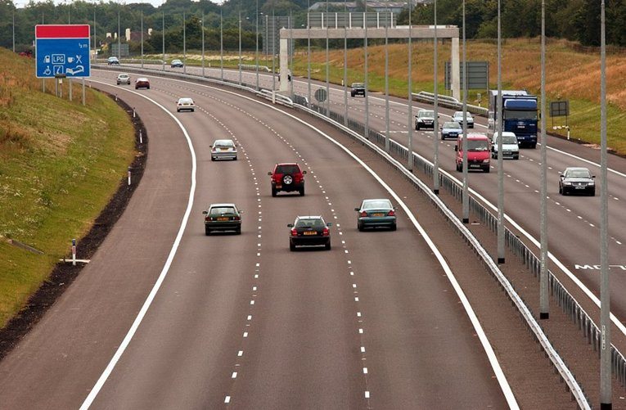

s-l-o-w
fastest
faster

Slide 9
Bus hierarchy (1980s)
Off-chip
cache L3*
Main
Memory
Cache
controller/
Bridge
CPU
Local Bus
System Bus
VDU
Serial
Keyboard
Disk
Expansion Bus
* what we now call L3 cache … in 1980 it was just “the cache”

Slide 10
Desirable features
There are some features that we would like our revised bus architecture to have:
Data transfer rate:
  want to support high transfer rates to service high demand I/O devices (e.g. VDU)
  want high demand devices closely integrated with CPU (for speed)
  want CPU-memory communication separate from CPU-other device communication
Notes:
see p41 Norton
Compatibility - I.e. ongoing support over the life of the machine
e.g. with newer PCs offering processor upgrades, want to ensure system is capable of fully utilising performance potential offered by CPU upgrading

Slide 11
Desirable features
Compatibility:
  want the I/O chips to be independent of the CPU (for ease up upgrade of system components)
  want backwards compatibility with existing I/O chips
Notes:
see p41 Norton
Compatibility - I.e. ongoing support over the life of the machine
e.g. with newer PCs offering processor upgrades, want to ensure system is capable of fully utilising performance potential offered by CPU upgrading

Slide 12
Bus architectures
Bus hierarchy had to evolve to cope with performance requirements of CPU and new applications e.g. fast graphics build-ups due to the proliferation of GUIs
The typical solution was to add another bus - known generically as the high-speed bus.
Notes:
p40 Norton
How the processor is attached to its memory
How the peripheral device adapters attach to the system
highway that enables the processor to talk to all system elements
See Fig 2.11 Norton

Slide 13
Bus hierarchy (1990s)
Main
Memory
Cache L2
Cache L3
Cache
controller/
Bridge
CPU
Local Bus
System Bus
VDU
Disk
High Speed Bus
Serial
Expansion bus bridge
Keyboard
Expansion Bus

Slide 14
Typical modern structure
The typical architecture in a Pentium-based PC would be:
  local bus
  system bus
  high-speed bus (PCI, AGP, PCIE, ATA(IDE), SCSI, SATA)
  expansion bus
All of these can be clocked at different speeds.
Notes:
Stallings p67-
p69
bus extends across all of system components, each of which taps into some or all of the bus lines
Pentium System Integrity Features
Parity checking on:
each byte of external data bus transfers
address bus
internal instruction and data caches
nearly all internal registers
internal ROM microcode
Second Pentium ( a checker) can be used to check all main processor outputs and report errors to main processor

Slide 15
Clocks - example
The device clocks are typically produced by multiplication or division of a main system clock:
DEVICE | SPEED | HOW?
Processor | 266 | System clock x 4
Level 2 cache | 133 | System clock x 2
System bus | 66 | System clock
PCI bus | 33 | System clock / 2
ISA bus | 8.3 | PCI / 4

Slide 16
On the buses
Local bus:
  very fast bus (~500MHz)
  connects CPU to cache memory (internally to CPU module) and the bridge chip
System bus:
  fairly fast bus (~100MHz)
  connects CPU to main memory
Notes:
Pentium - address pipelining allows 2 outstanding bus transactions

Slide 17
On the buses
High speed bus (~33MHz):
  supports high-speed peripheral devices e.g. hard disk, VDU, high-speed LANs
Expansion bus (~8MHz):
  supports medium/low speed peripherals
  provides backward compatibility to existing I/O chips (some adapter boards don’t work, or are unreliable, at higher speeds)

Slide 18
ISA Bus
Industry Standard Architecture (ISA) bus (1984 by IBM) - an example of an expansion bus:
  8.3 MHz ➔ 16 Mbytes per second
  16 data lines (originally 8)
  24 address lines
  3 DMA channels
  14 interrupt levels
Notes:
Some intermediates - ISA and EISA
EISA Bus
Extended Industry Standard Architecture
32 data lines
33 MB/s
backward compatible with ISA, and the preceding PC-AT and PC-XT buses
expensive, and few applications saw performance improvements
never caught on as mainstream architecture, apart from high performance server applications
VESA Local bus systems
VESA - Video Electronics Standards Association
Display adapter moved to local bus
removed bottleneck of processor’s access to display memory for Windows screen updates
Typically up to 3 slots available for local bus attachments

Slide 19
PCI bus
Peripheral Component Interconnect (PCI) bus (1993 by Intel) - a typical high-speed bus:
  33MHz ➔ 127 Mbytes per second with 32-bit data bus, also 66MHz version
  CPU independent bus (if CPU and local bus changed, we need to change bridge chip, but not the I/O devices)
  attaches to the local bus via a local-bus-to-PCI bridge chip
Notes:
well defined electrically and functionally
becoming the dominant bus architecture
p75- Stallings

Slide 20
PCI bus (continued)
Support for other buses to be connected, e.g. 2 to 3 expansion ports available.
PCI uses time-multiplexing - certain lines used alternatively to transfer address and data.
For block transfer, PCI can operate in block mode, which is faster - only the first address and the size of the block need be transferred.
Very flexible - used in servers, desktops, laptops, processor independent.

Slide 21
DMA and the PCI
It is normal that DMA modules can gain control of the PCI bus - usually several DMA modules connected.
An arbitration scheme is used to resolve requests from distinct bus masters (i.e. the CPU and DMA) - arbitration algorithm could be 1st-come-1st-served, round robin, priority etc.
PCI supports up to 10 loads, where:
  a motherboard chip/device is 1 load
  expansion slot is 2 loads

Slide 22
Disk drives
Advanced Technology Attachment (ATA) bus (1986 by Western Digital) - for (internally) attaching disk drives and other storage devices:
  a.k.a. Intelligent Device Interface (IDE)
  up to 133 MBps, 2 drives per device
Small Computer Systems Architecture (SCSI) bus (1986) similar:
  originally faster, but IDE caught up!

Slide 23
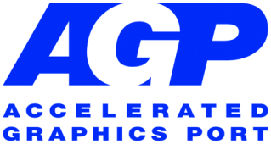
AGP
Accelerated Graphics Port (1996 by Intel) is similar to PCI, but was designed especially for the throughput demands of 3-D graphics:
  dedicated 32-bit point-to-point channel to allow the graphics controller to access main memory directly (separate from PCI bus)
  66 MHz ➔ 266 MBps
  two optional faster modes, with throughputs of 533 MBps and 1.07 GBps

Slide 24
Bus hierarchy (2000)
L2 cache
2 GBps
CPU core
System 800 MBps
Graphics chip
AGP
528 MBps
System
800 MBps
Main memory
Memory bridge
I/O bridge
Graphics memory
USB
SCSI
IDE
PCI 132 MBps
Local bridge
LAN
PCI slots
ISA 28 MBps
BIOS
RT clock
Keyboard
Mouse
Serial

Slide 25
Serial’s Revenge
Although the parallel buses are fast, carrying multiple signals at the same time, the addition of so many high-bandwidth devices onto the broadcast buses was clogging them up.
The solution was to instead connect devices point-to-point using high-speed serial links … the new serial standards are similar to network protocols, allowing much faster speeds than RS-232 and similar standards.

Slide 26

USB
Universal Serial Bus (1996) designed as replacement for all contemporary serial and parallel peripherals:
  fast, robust, simple - hence cheap
  hot-swappable - can be safely connected / disconnected without turning off the power
  3 speeds in USB 2.0 (Low - 187KBps, Full - 1.5MBps, Hi - 60MBps)
  widely adopted by hardware + software vendors for PCs, PDAs, consoles etc.

Slide 27
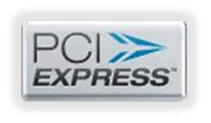
PCIe
PCI Express (2004 by Intel) was designed to replace PCI (and AGP). PCIe is a scalable, serial point-to-point bus based on “lanes”:
  a lane carries 256 MBps in each direction
  faster transfers can just use more lanes
  specification supports up to 32 lanes = 16 GBps duplex!

Slide 28
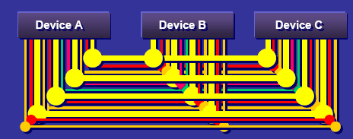
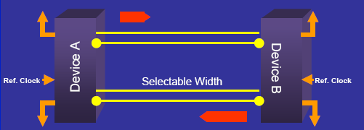
PCIe
Serial basis means simpler wiring / connectors and allows hot swap of devices.
Now standard for graphics cards, becoming standard for other devices.
PCI
PCI Express

Slide 29

SATA
Serial ATA (2003) was designed to replace IDE/ATA (now PATA) for internal storage devices:
  serial, point-to-point, hot-swappable (sometimes)
  up to 375 MBps

Slide 30
Remember …
Remember that each of these different types of bus has within it:
  an address bus
  a data bus
  a control bus
In older systems, there was only one type of each. In modern systems, we now have the multi-layered bus hierarchy, with different address, data and control buses within each.

Slide 31
Bus hierarchy (now) concept
CPU
End pt
End pt
Main memory
Host bridge
End pt
Switch
End pt
End pt
End pt
End pt
End pt
End pt
End pt

Slide 32
Bus hierarchy (now) actual
L2 cache
CPU core
CPU core
L2 cache
L3 cache
Graphics
Main memory
Memory bridge
SATA
I/O Bridge
PCI
USB
Switch
End pt - LAN
Local bridge
End pt - etc
BIOS
RT clock
Keyboard
Mouse
Serial

Slide 33
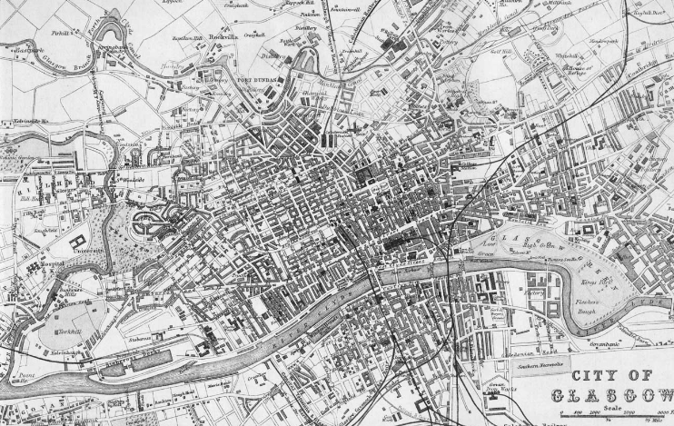
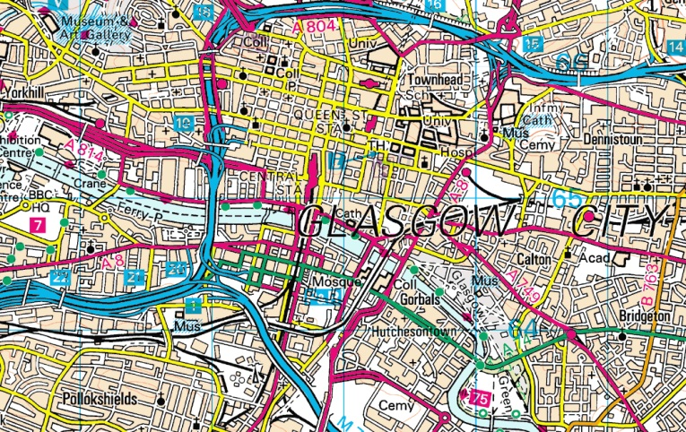
Summary
Ye Olde Days
Not much traffic
One type of route
Today
Lots of traffic
More routes
Routes with variety of speeds/capacities

Slide 34
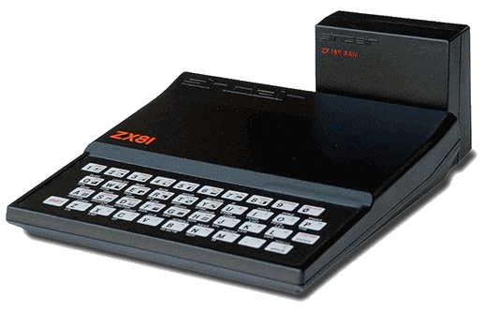
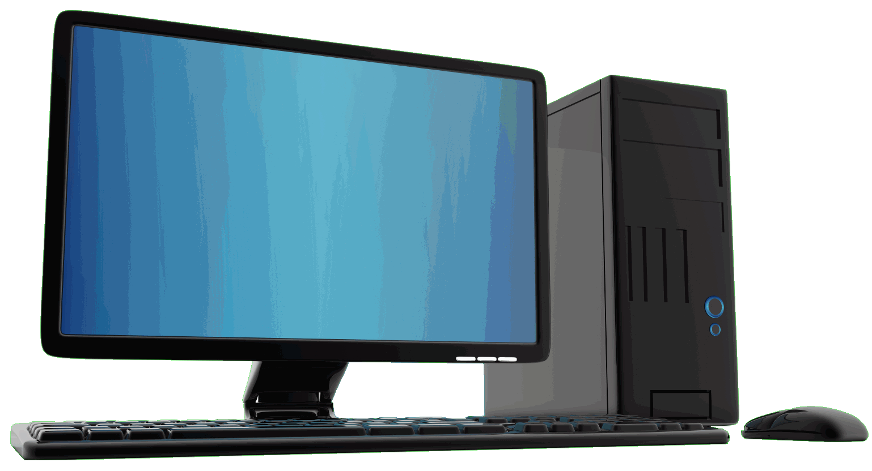
Summary
Ye Olde Days
Not much traffic
One type of route
Today
Lots of traffic
More routes
Routes with variety of speeds/capacities

Slide 35
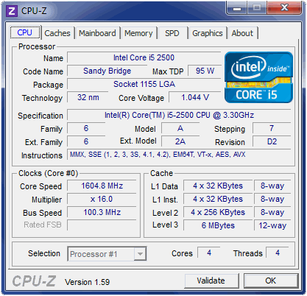
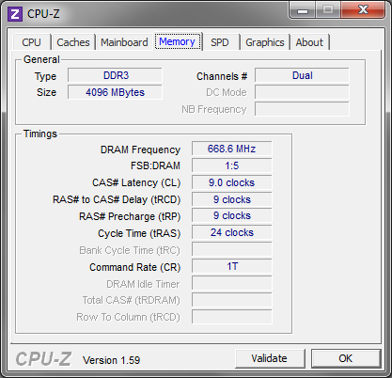
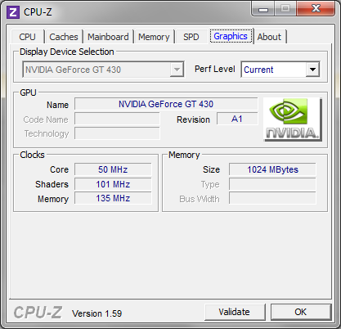
CPU-Z
Notes:
Stallings p67-
p69
bus extends across all of system components, each of which taps into some or all of the bus lines
Pentium System Integrity Features
Parity checking on:
each byte of external data bus transfers
address bus
internal instruction and data caches
nearly all internal registers
internal ROM microcode
Second Pentium ( a checker) can be used to check all main processor outputs and report errors to main processor

Slide 36

PC system unit
A typical PC system unit will contain:
  motherboard (with CPU, memory etc.)
  adapter boards (in motherboard’s expansion slots)
  power supply
  drive expansion bays for:
    1 or more hard drives (SSDs coming)
    1 or more CD-ROM/DVD drives
… and probably several fans …
Notes:
Power supply
AC converted to +5, +12, -5 and -12 volts
AC voltage to monitor
keyboard and mouse power via interface cables
Typical rating
Desktop 150-220 watts
Tower 220-400 watts (more hard drives and adapter boards supported)
Fan cools power supply and system unit
fan may also cool CPU directly

Slide 37
Motherboard - components
  CPU (usually removable)
  (Cache) / RAM + controller chip
  Bridge chips (PCI-to-local bus & PCI-to-ISA)
  Integrated adapters and expansion ports, e.g. display, keyboard/mouse, LAN, SCSI, IDE
  ROM BIOS
  Real-time clock/calendar (non-volatile)
Notes:
See Norton Figure 2.27
Text - See p 60-Norton
Memory subsystem
cache/memory controller chip
bridges between local bus and DRAMS and manages filling of cache from DRAMS
ISA to PCI bridge chip
Bridges between PCI and older ISA or PC-AT bus
Allows backward compatibility with older expansion bus devices and controllers
Contains Intel ‘core circuits’, e.g.
DMA
Interrupt control

Slide 38
ROM BIOS
  loads basic operating system software from start-up device (e.g. hard disk/LAN port)
  performs power-on system tests
  typically 64-128KB ROM, contents moved to DRAM for execution
  typically, also support for system configuration detection and resource allocation as defined by Plug and Play specification

Slide 39
Today’s summary
We have seen:
  PC bus architecture
  development of bus hierarchies from 1980 - present
  details of main bus standards
  main hardware features of a PC

Slide 40
Section summary
Our 1980s microcomputer was functional – but s-l-o-w! We have improved throughput by:
  increasing silicon speed (Moore’s Law)
  reducing the amount of slow memory accesses (using caches)
  adding instruction-level parallelism (by using pipelines)
  increasing pipeline efficiency (by using branch prediction)
  …

Slide 41
Section summary
  improving I/O efficiency by adding DMA
  reducing queuing delays (by buffering I/O)
  increasing overall system efficiency (by using a bus hierarchy)
  adding thread-level parallelism (by using super-scalar architecture
All of these make our system more complex, but that’s OK if it’s faster, because …
It’s all about speed!

Slide 42
Coming soon …
  Tomorrow at 0900
    Lab - remaining C# demonstrations
  Tomorrow at 1100
    Prof Arnott takes over completely with the Operating Systems section

